Slide 1

Multiscale Modeling of the CRUD Source Term in Pressurized Water Reactors
Penghui Cao¹, Derek Gaston², Daniel Wells³, Dennis Hussey³, Michael Short¹
¹ Department of Nuclear Science and Engineering, MIT, USA
Idaho National Laboratory, Idaho Falls, ID, USA
² Electric Power Research Institute (EPRI), Palo Alto, CA & Charlotte, NC, USA
TMS-2016, Nashville, TN
February 15, 2016

Slide 2
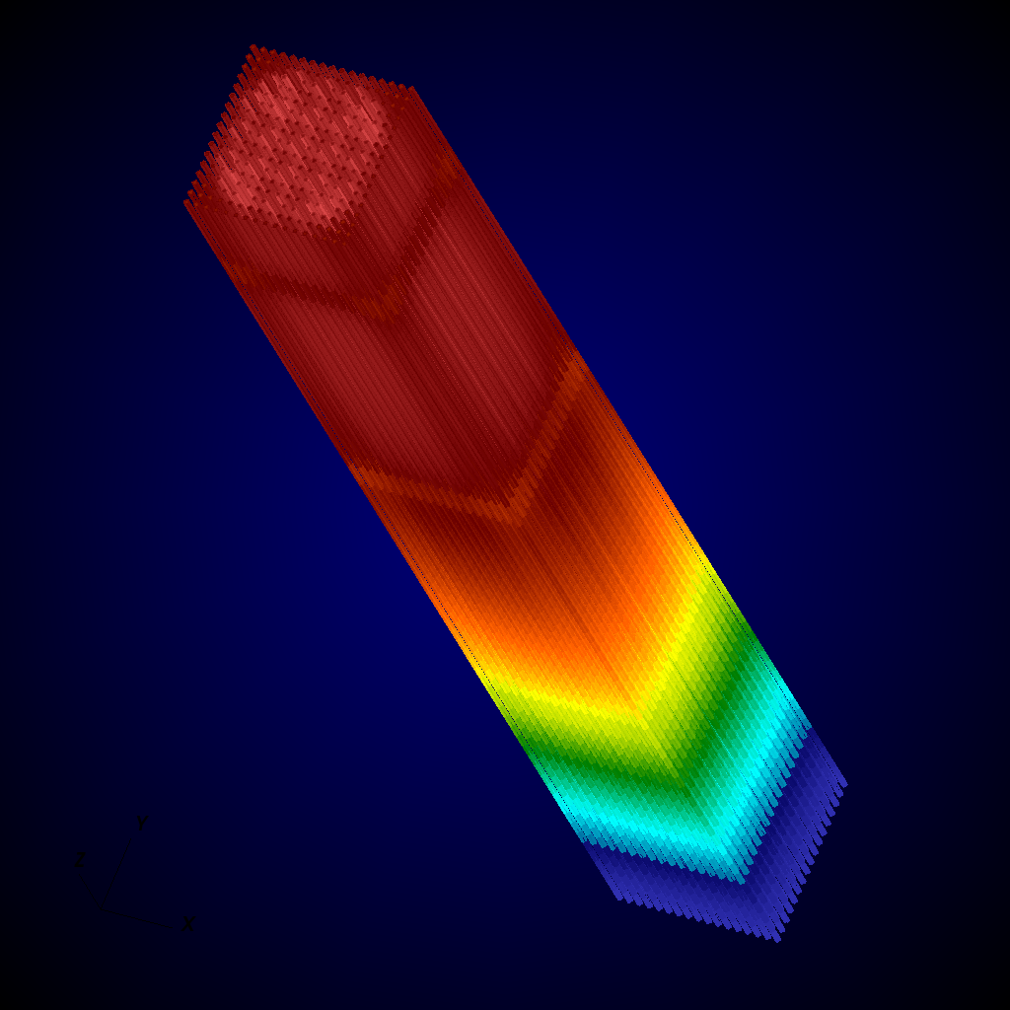
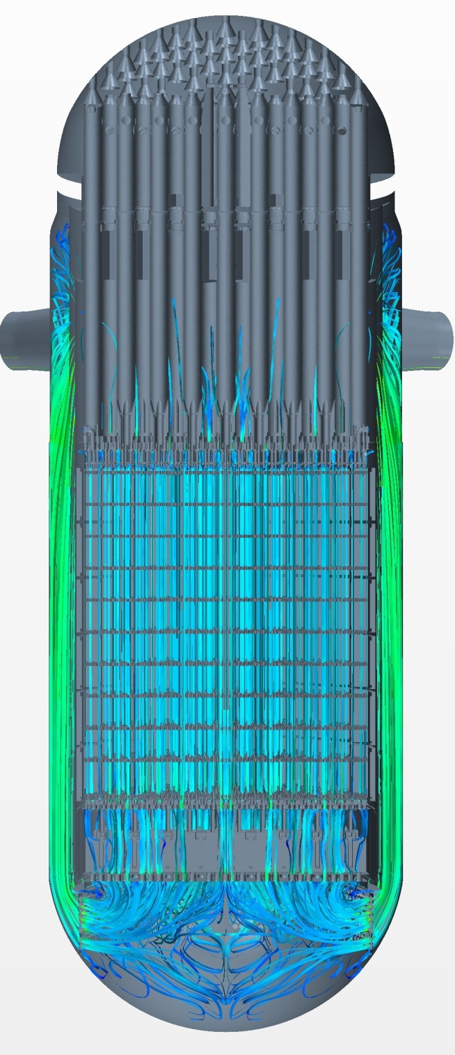

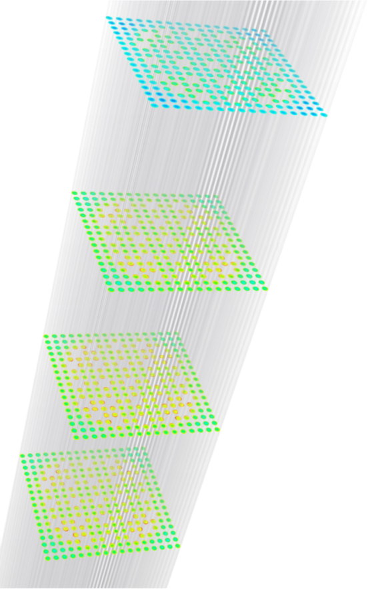
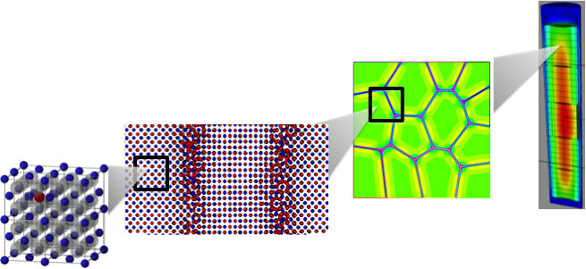
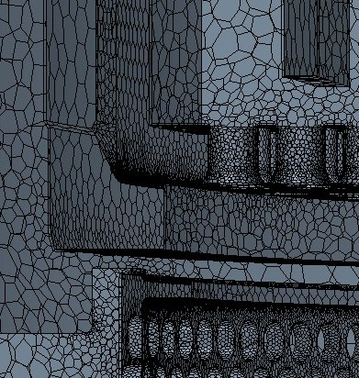
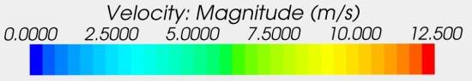
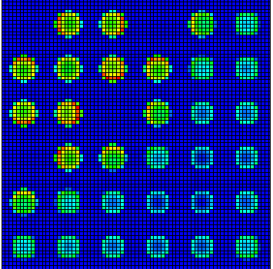

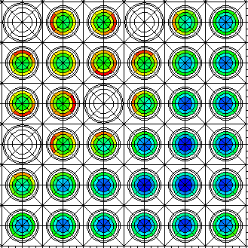
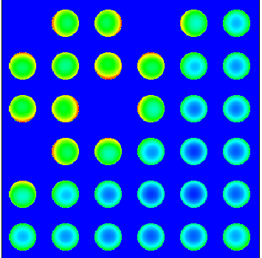
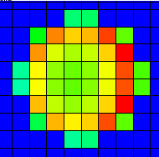
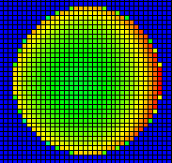
Multiscale Modeling for Nuclear Reactors
Many efforts, with CASL¹ leading the way
¹Consortium for the Advanced Simulation of Light Water Reactors
DENOVO 12x12
DeCART
Source: CASL 2012 Round Table Meeting
DENOVO 50x50

Slide 3
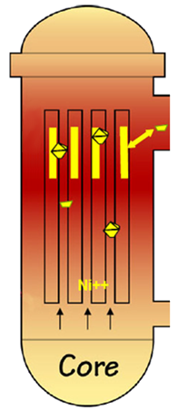
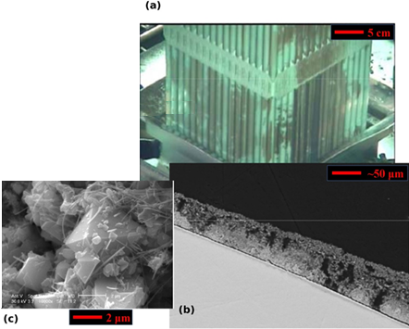
Multiscale Modeling: Focus on CRUD
Chalk River Unidentified Deposits: Corrosion deposits on fuel rods
Corrosion products deposit as CRUD on fuel rods
To hot leg
CRUD constituent phases
What about the CRUD source term?
CRUD cross section showing typical structure
To cold leg
Short, M. P.,et al. MRS-B 39(1):71-77 (2014)
CASL phase I scope

Slide 4
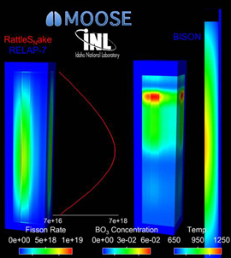
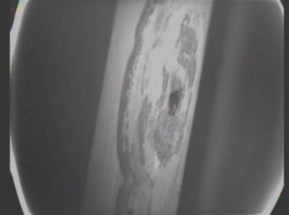
What Is CRUD? Why Does It Matter?
Chalk River Unidentified Deposits: Causes operational problems like:
Axial downward power shift
CRUD-induced localized corrosion
Core Height
CRUD induced power shift
“Leaker” fuel failures
BO₃ Concentration
Power
Image: D. Gaston et al. Ann. Nucl. Ener., doi: 10.1016/j.anucene.2014.09.060 (2014)
Image: D. Wells. EPRI Summer P-TAC Meeting (2013)

Slide 5
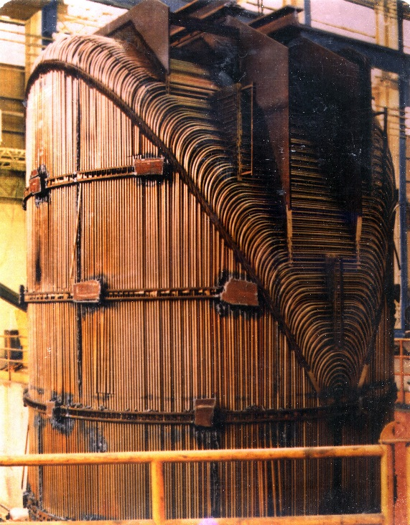
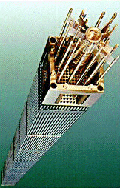
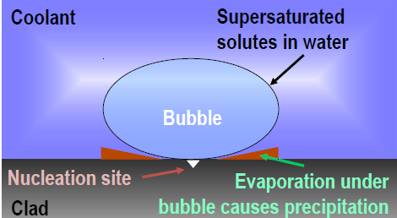
What Leads to CRUD?
There must be a source term, a sink, and a driving force
PWR Steam Generator
Sources: Wikimedia, Thermopedia

Slide 6
Planning a Multiscale CRUD Model
Understand the system, and its basic physics
Choose the framework, craft a workflow
Make justified assumptions
Uncover missing parameters
Integrate
Validate
Validate again, then validate some more!

Slide 7

First: An Overall System View
Where does CRUD come/go in a PWR primary loop?
Hot Leg: 304SS, ~330C
Steam Generator: Alloy 600/690, 330C (Inlet) to 290C (Outlet)
Core: Contains fuel rods with sub-cooled boiling, removing particulates
Cold Leg: 304SS, ~290C

Slide 8
High-Level Model Overview
Model sections as straight or U-bend pipes
Impose temperature, compute oxidation at each point
SG: Alloy 600 or 690
Releases Ni/Fe via corrosion through oxides
Absorbs Ni/Fe via NiFe₂O₄ growth
Core: Separate code
Absorbs Ni/Fe via crud growth
Model for now as a straight pipe w/temperature gradient
Hot/Cold Legs:
304 Stainless Steel
Releases Ni/Fe via corrosion through oxides
Absorbs Ni/Fe via NiFe₂O₄ growth

Slide 9
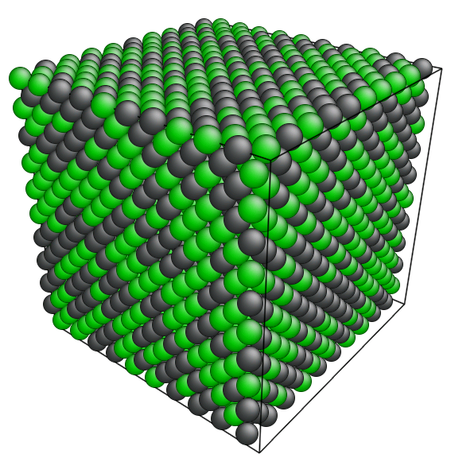
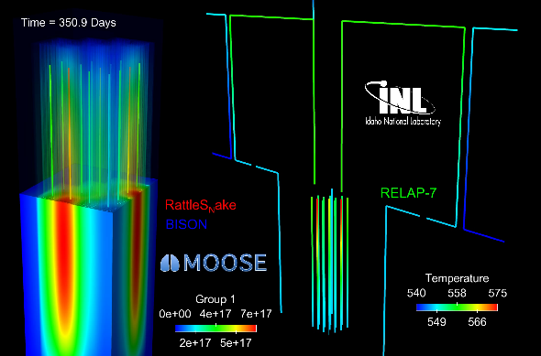
Next: Choose Main Approaches & Tools
Molecular Dynamics (LAMMPS, Sandia)
E. Broitman, R. Becker et al. PRICM-8, 2013.
MOOSE MultiApps, Transfers
MOOSE Mesoscale Oxidation, Diffusion Path Analysis
D. Gaston et al., INL Multiphysics Group, 2013.
Fill in missing parameters
Compute local metal release rates
Integrate entire system for total CRUD source term

Slide 10
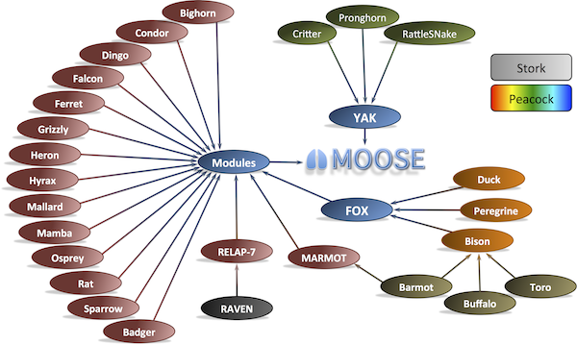
Planning for Flexibility, Expandability
Take the time to choose/develop your modeling framework
We chose MOOSE, for its abstraction, expandability, and existing tools
Finite element framework
Contains many existing, useful modules for our CRUD source problem
Phase field module: Useful for oxidation kinetics
CRUD deposition
1D nodal fluid flow
HUGE existing fuel performance code
Source: http://www.mooseframework.org/about/

Slide 11
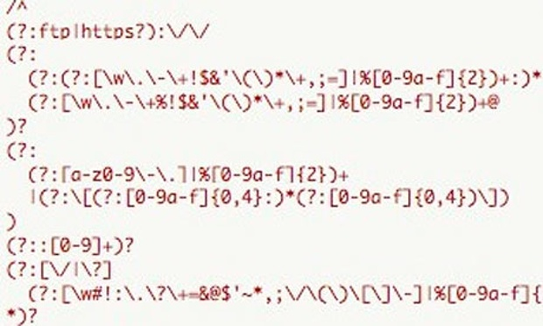
Planning for Flexibility, Expandability
Take the time to develop an efficient workflow
Learn scripting to automate tasks, regular expressions to script faster
If you have to repeat yourself, stop and script!
Source: C. Doctorow. The Guardian, 12/4/2012

Slide 12
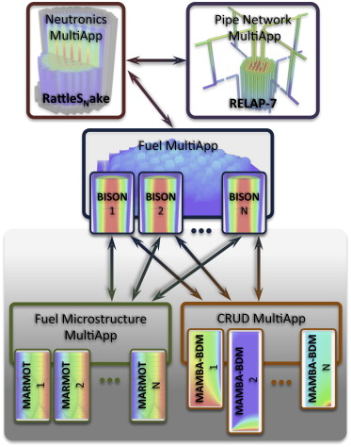
Planning for Flexibility, Expandability
Think about the problem in a modular way
Each piece of physics should be able to stand alone
Decide on coupling strategy, interscale communication early
Will save lots of time later!
Multiphysics simulation framework for coupling CRUD and microstructure effects into fuel performance. Source: Gaston, D., et al. Ann. Nucl. Ener. 84:45-54 (2015).

Slide 13
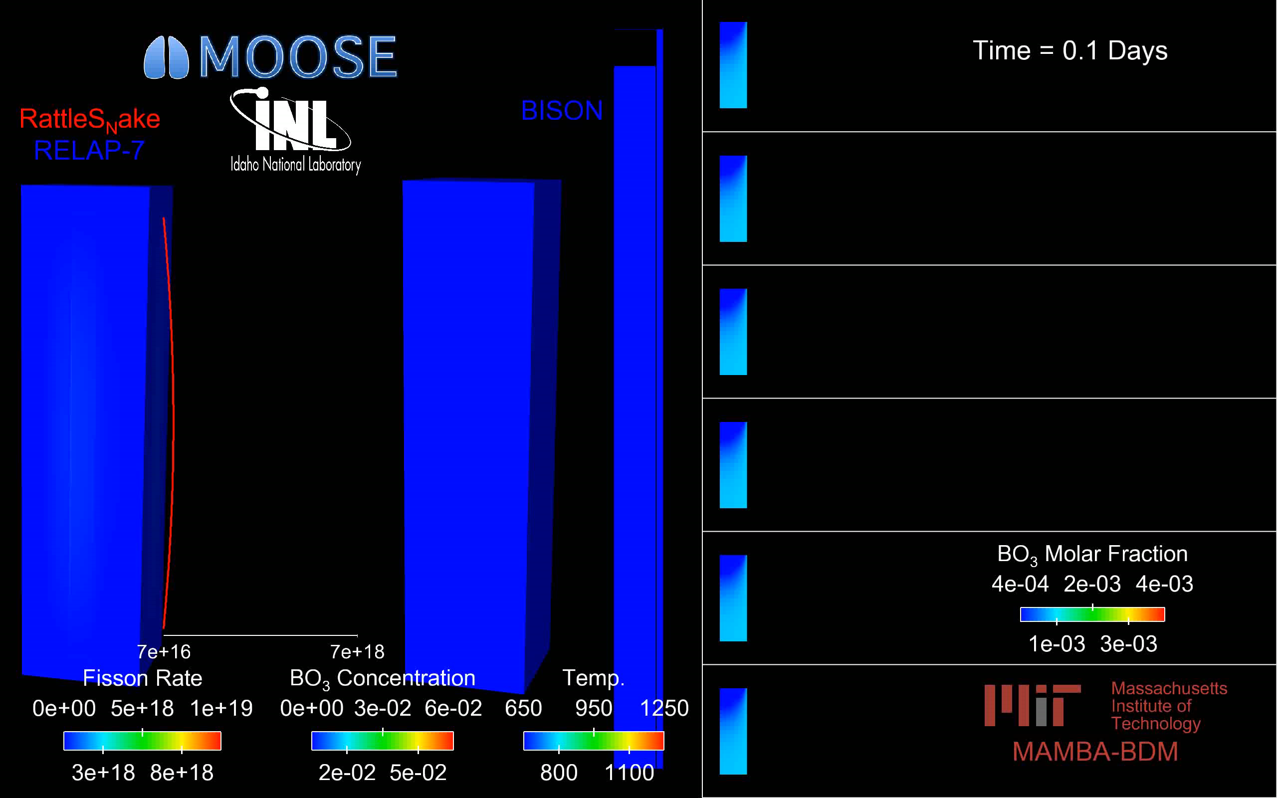
Planning for Flexibility, Expandability
Take the time to visualize intermediate variables
Time spent now pays off 1,000x later
Effectively sets up an automatic debugging system for you
Video: CRUD’s effects on the KAIST3A neutronics benchmark. Source: Computational Multiphysics Group, Idaho National Laboratory

Slide 14
Delineating Scales and Interscale Communication
Calculate local Fe, Ni release rates
Molecular Dynamics (LAMMPS, Sandia)
E. Broitman, R. Becker et al. PRICM-8, 2013.
MOOSE MultiApps, Transfers, RELAP-7
MOOSE Mesoscale Oxidation, Diffusion Path Analysis
D. Gaston et al., INL Multiphysics Group, 2013.
Pre-computed diffusivity relations
Recalculate environmental conditions

Slide 15
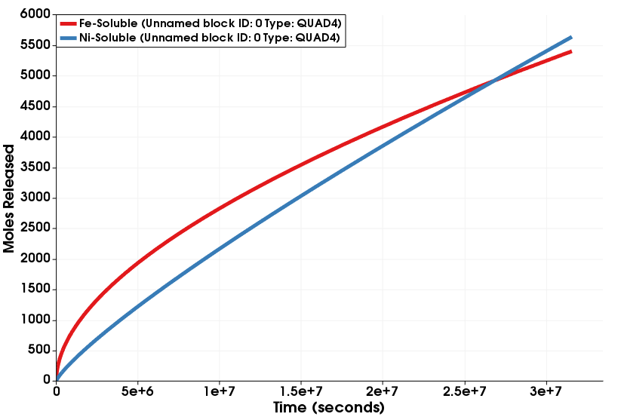
Engineering Scale: What Is Missing?
Ultimate goal: Predict the Ni & Fe metal release terms
Acts as source term for CRUD deposition codes (MAMBA¹, BOA²)
? ? ?
¹ Developed by CASL
² Developed by EPRI

Slide 16
Microscale: What Is Missing?
Assumptions about which oxides are important
Diffusivity data to determine metal release fluxes

Slide 17
Observations of CRUD from PWRs
Mostly NiFe₂O₄ crystallites
Some NiO, Fe₃O₄
Source term appears to be particulate
Short, M. P.,et al. MRS-B 39(1):71-77 (2014)

Slide 18
Observations Become Justified Assumptions
All reactor internals create NiFe₂O₄ outer oxide crystals
Alloy 600 corrosion
Alloy 690 corrosion
Alloy 600 oxide film
P. Combrade et al. “OXIDATION OF NI BASE ALLOYS IN PWR WATER: OXIDE LAYERS AND ASSOCIATED DAMAGE TO THE BASE METAL.” Proceedings of the 12th International Conference on Environmental Degradation of Materials in Nuclear Power System – Water Reactors – Edited by T.R. Allen, P.J. King, and L. Nelson TMS (The Minerals, Metals & Materials Society), 2005

Slide 19
Observations Become Justified Assumptions
Saturation near 1ppb in PWR, fractions of a mole in 138m³ of coolant
Source: T. Devine. “Diffusion Path Analysis of Alloy 600’s and Alloy 690’s Passive Films and Understanding/Predicting Cation Release Rates.” P-TAC Presentation, Nov. 2013.

Slide 20

Choosing What (NOT) To Model
Low Ni,Fe High Ni,Fe
in coolant in coolant
Flow, Erosion
600 | 690 | 304
600 | 690 | 304
NiFe₂O₄
(Ni,Fe)(Cr,Fe)₂O₄
(Ni,Fe)Cr₂O₄
Cr₂O₃
Metal with (Cr,Ni) depletion zone
Base alloy
O
Fe
Cr
[1] [1] [1] [1] [2]
Diffusion/Transport
Missing diffusivity data
[1] T. Devine, ibid
[2] S Cisse et al. Corr. Sci., 56:209-216 (2012).

Slide 21
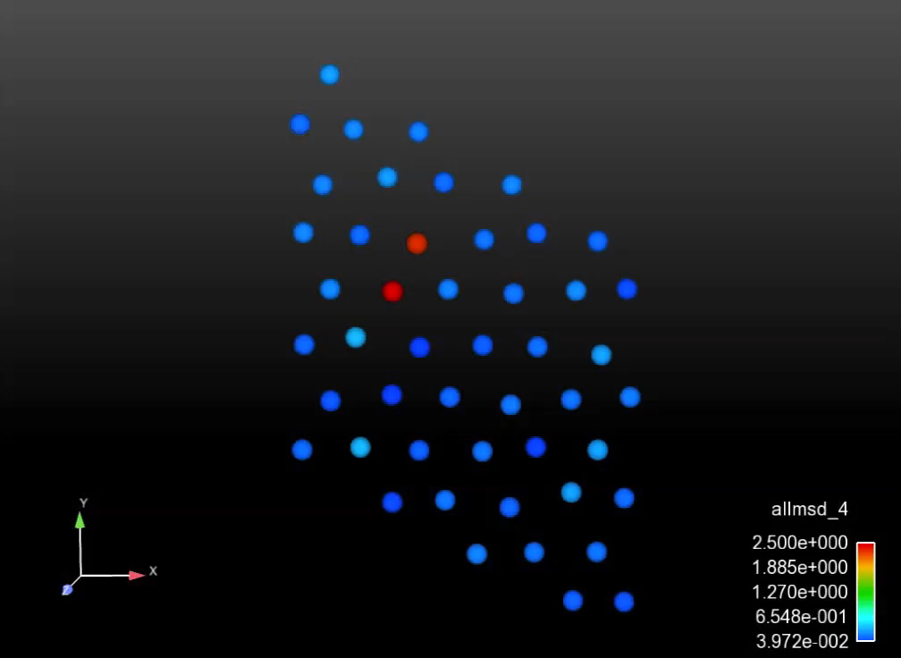
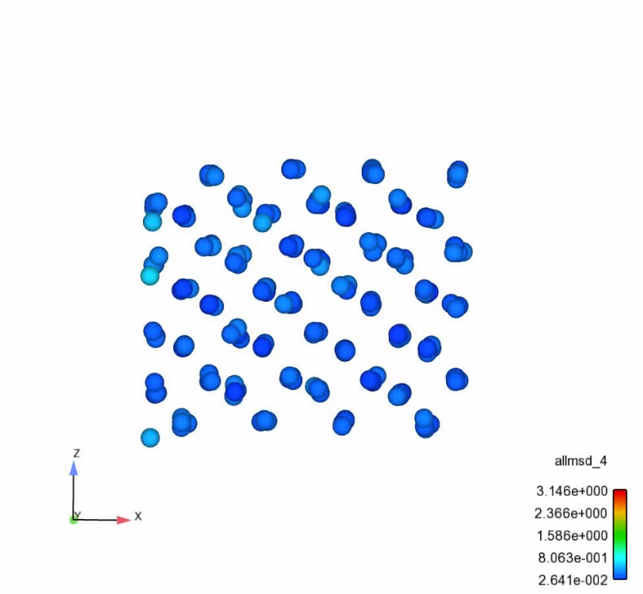
Atomistic Scale: What Is Missing?
Diffusivity prefactors, activation energies for metal diffusion through oxides
Mechanisms for diffusion of cations through oxides
Oxygen diffusion through Cr₂O₃
Cation diffusion through Cr₂O₃

Slide 22
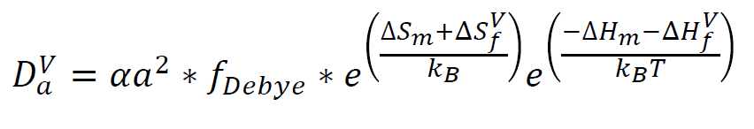
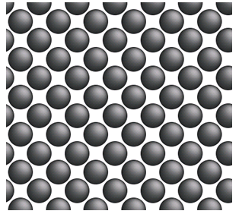
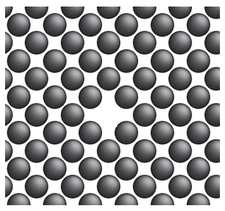
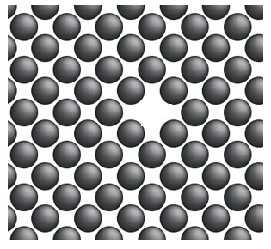
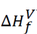
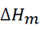
Computing Unknown Diffusivities

Slide 23
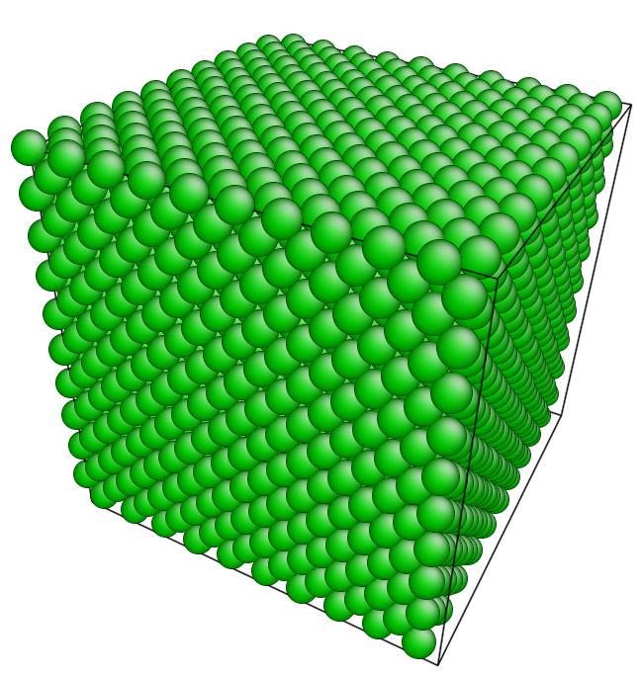
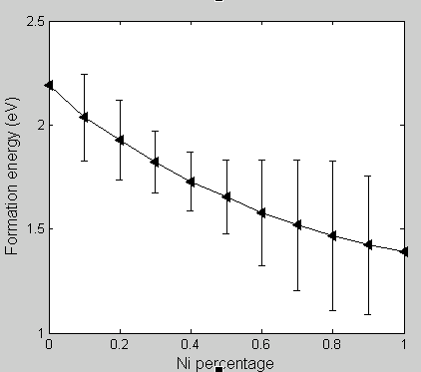
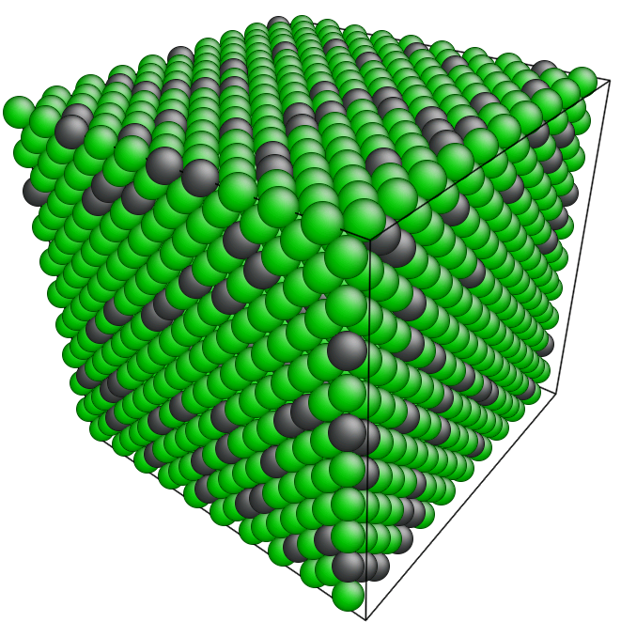
Computing Unknown Diffusivities: Cr-Ni Metal
Ni50Cr50
Cr
Ni10Cr90
E_{v}^{f}(Ni) is 1.39 eV
E_{v}^{f}(Cr) is 2.19 eV
Build large cube of an Fe-Cr-Ni alloy, calculate system energy
Remove one atom at a time, recalculate system energy
Repeat steps 1-2 for every atom in every alloy, get statistics

Slide 24
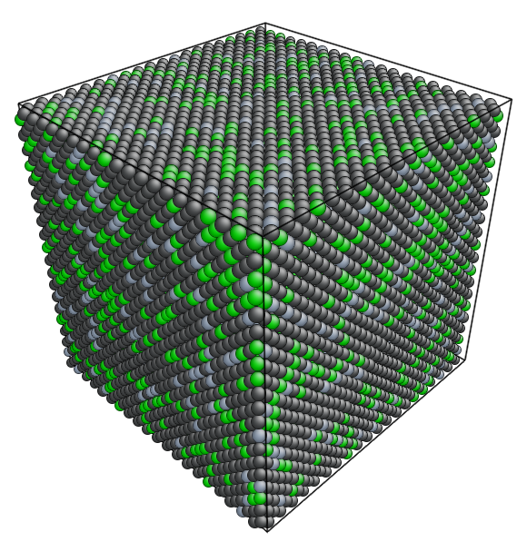
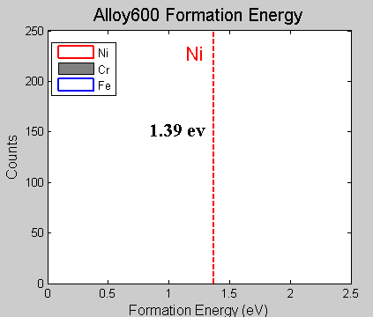
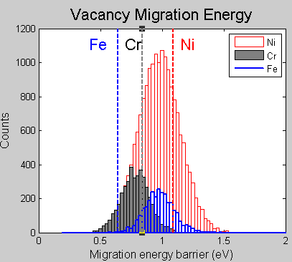
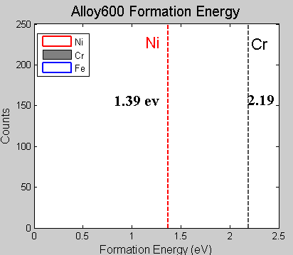
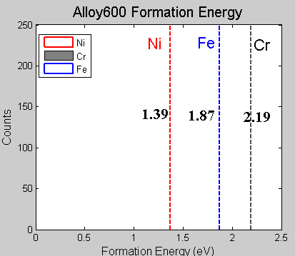
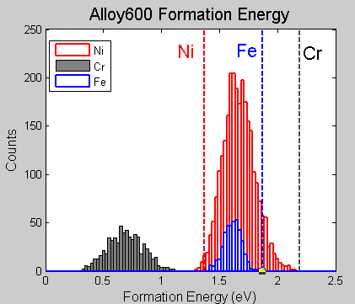
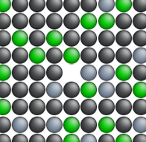
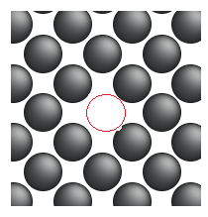
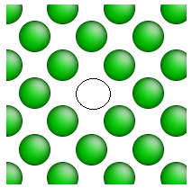
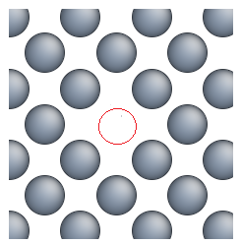
Computing Unknown Diffusivities: Alloy 600
Alloy 600 --Vacancy Formation and Migration Energies
Cr Vacancy
Ni Vacancy
Fe Vacancy

Slide 25
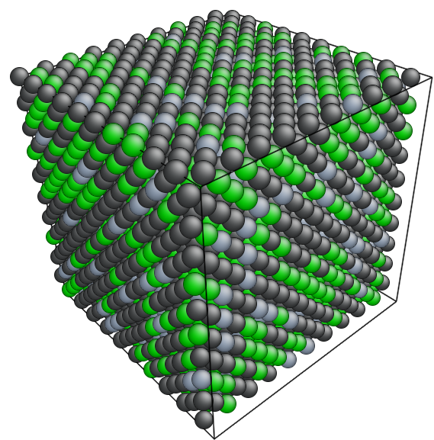
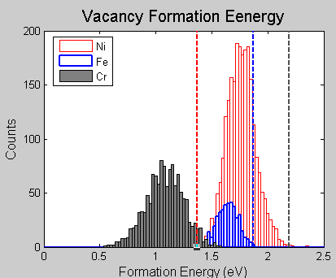
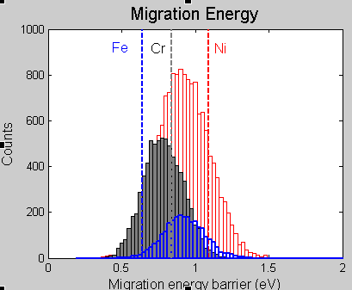
Computing Unknown Diffusivities: Alloy 690
Alloy 690 --Vacancy Formation and Migration Energies

Slide 26
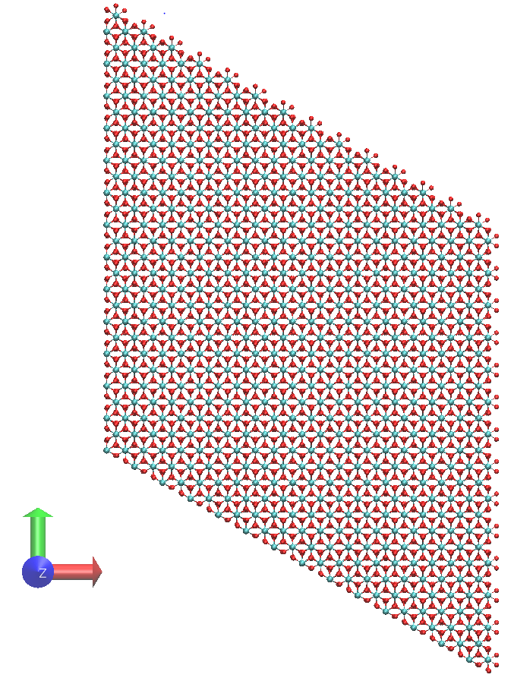



Computing Unknown Diffusivities: Cr₂O₃
Buckingham potential: Compensates charge loss due to ionic defects [1-2]
Model: 18x18x6 hexagonal unit cell with periodic boundary conditions, 58,320 atoms
[1] R. Grimes. Phil. Mag. A, 72(3):651-668 (1995).
[2] Minervini et al., J. Mater. Chem., 10:2349-2354 (2000).

Slide 27


Computing Unknown Diffusivities: O in Cr₂O₃
Path 1
Path 2
Path 3
Path 4
Path 5
Path | Migration barrier (eV) | Jump distance (Å) | $$d_{ab}$$ (in-plane) | $d_{c}$ (out of plane)
1 | 0.425 | 2.63 | 2.63 | 0
2 | 2.38 | 2.99 | 2.99 | 0
3 | 1.38 | 2.74 | 1.53 | 2.27
4 | 1.63 | 2.85 | 1.72 | 2.27
5 | 5.532 | 4.13 | 3.45 | 2.27
In-plane diffusion
Out-of-plane

Slide 28




Unknown Diffusivities: Cr in Cr₂O₃
Path | Migration barrier (eV) | Jump distance d (Å) | $$d_{ab}$$ (in-plane) | $d_{c}$ (out-of-plane)
1 | 0.971 | 2.87 | 2.84 | 0.385
2 | 8.19 | 4.96 | 4.96 | 0
3 | 7.86 | 5.74 | 5.73 | 0.385
4 | 2.67 | 2.65 | 0 | 2.65
5 | 1.23 | 6.41 | 0 | 6.41
2
3
5
1
4

Slide 29

Diffusion Coefficients in Cr₂O₃
O diffusivity: $D\left(T\right)=7.5$x${10}^{−4}e^{(−4.42/k_{B}T)}$ (plus doping effects)
Cr diffusivity: $D\left(T\right)=1.97$x${10}^{−5}e^{(−4.55/k_{B}T)}$
Fe diffusivity: $D\left(T\right)=1.51$x${10}^{−6}e^{(−4.02/k_{B}T)}$
Ni diffusivity: $D\left(T\right)=1.50$x${10}^{−5}e^{(−4.28/k_{B}T)}$

Slide 30
Unknown Diffusivities: (Fe,Ni)Cr₂O₄
Compute with high vacancy density (like high temperature)
Scale down to correct temperature’s vacancy concentration

Slide 31
Unknown Diffusivities: (Fe,Ni)Cr₂O₄
Compute with high vacancy density (like high temperature)
Scale down to correct temperature’s vacancy concentration

Slide 32




Overall Diffusion Coefficients
O diffusivity: $D\left(T\right)=7.5$x${10}^{−4}e^{(−4.42/k_{B}T)}$
Cr diffusivity: $D\left(T\right)=1.97$x${10}^{−5}e^{(−4.55/k_{B}T)}$
Fe diffusivity: $D\left(T\right)=1.51$x${10}^{−6}e^{(−4.02/k_{B}T)}$
Ni diffusivity: $D\left(T\right)=1.50$x${10}^{−5}e^{(−4.28/k_{B}T)}$
$$Diffusion in {Cr}_{2}O_{3}$$
$$Diffusion in \left(Ni,Fe\right){Cr}_{2}O_{4}$$
Oxygen diffusivity: $D\left(T,r\right)=r∗$1.9x${10}^{−3}e^{(−5.85/k_{B}T)}$ + (1-r)*2.5x${10}^{−4}e^{(−5.73/k_{B}T)}$
Cr diffusivity: $D\left(T,r\right)=r∗6.0$x${10}^{−6}e^{(−10.1/k_{B}T)}$ + (1-r)*5.6x${10}^{−6}e^{(−9.75/k_{B}T)}$
Fe diffusivity: $D\left(T,r\right)=6.1$x${10}^{−5}e^{(−3.39/k_{B}T)}$
Ni diffusivity: $D\left(T,r\right)=1.0$x${10}^{−5}e^{(−3.32/k_{B}T)}$ Composition: (Fe_{r}Ni_{(1-r)})Cr₂O₄

Slide 33
Microscale Model Assumptions
Only the innermost oxide layer is protective
NiFe₂O₄ growth happens from supersaturated coolant, not diffusive transport
Just represents a time delay in particulate release of NiFe₂O₄, NiO
304 Stainless Steel
Source: T. Devine. “Diffusion Path Analysis of Alloy 600’s and Alloy 690’s Passive Films and Understanding/Predicting Cation Release Rates.” P-TAC Presentation, Nov. 2013.

Slide 34

Microscale Model Assumptions: Oxide Thickness
Used experimental data from oxidation of A600, A690, 304SS at PWR conditions
325-350C, 1200ppm H₃BO₃, 2ppm LiOH, pH ~ 7.2, 25-30 cc/kg H₂
A. Machet, A. Galtayries, S. Zanna, P. Jolivet, M. Foucault, P. Combrade, P. Scott, and P. Marcus, “Kinetics of passivation of a nickel-base alloy in high temperature water,” presented at the EUROCORR 2004, Nice (France), 2004.
L. Guinard, C. Gabet, T. Czerwiec, E. Riquelme, and O. Kerrec, “Effect of surface passivation of Inconel 690 on oxidation in primary circuit conditions,” presented at the
Water Chemistry of Nuclear Reactor Systems 8, BNES, vol. 1, p. 67, 2000.
Program on Technology Innovation: Review of Oxidation and Surface Film Formation Studies
on Austenitic Alloys in Light Water Reactor Coolants. EPRI, Palo Alto, CA: 2015. 3002005478

Slide 35




Feed Microscale into Engineering Scale
Microscale model computes Fickian flux, feeds areal release rate up to engineering scale
$$C_{i} (Concentration)$$
Prescribed thickness vs. time
A600, A690, SS304
$$J_{i}=D_{i}\frac{dC_{i}}{dx}$$
$$C_{i}=C_{metal}$$
$$x$$
Metal
Oxide

Slide 36

Feed Microscale into Engineering Scale
Assume grain boundary diffusivity increases lattice (bulk) diffusivities by ~3 orders of magnitude
$$D_{eff}≈1,000×D_{b}$$
A. C. S. Sabioni et al. “Diffusion of iron in Cr2O3: polycrystals and thin films.” Mat. Sci. Eng. A, 392:254-261 (2005)

Slide 37

Putting it All Together
Compute local metal release rate at every location & time step
Diffusivities, oxide thicknesses are functions of space & time
Temperature profiles prescribed along loop, also functions of space & time
Temperature-dependent diffusivity
Concentration of species i in local metal
Local release rate
Quadrature point
Local wetted perimeter
$${RR}_{i}\left[qp\right]\left[\frac{moles}{m×s}\right]=\frac{D_{i}\left[qp,T\right]∗C_{i}\left[qp\right]∗wp\left[qp\right]∗ND[qp]}{x_{oxide}\left[qp,t\right]∗6.02×{10}^{23}\frac{atoms}{mole}}$$
Atomic number density
Species i (Fe or Ni for now)
Diffusion Flux (m²/s)
Prescribed oxide thickness vs. time & type
Avogadro’s number

Slide 38

Putting it All Together
Integrate to get total loop metal release vs. time
Uses MOOSE postprocessor to integrate
Account for deposition due to CRUD with any of:
$$\int_{x=0}^{x=x_{max}}{{RR}_{i}\left[qp\right]dx=Release(t)\left[\frac{moles}{sec}\right]}$$
Loop particulate concentration
Boiling rate
Turbulent kinetic energy from CFD
$$\int_{x=0}^{x=x_{max}}{DR\left(t\right)=\left[{A∗C}_{NiFe2O4}\left(t\right)∗BR\left(qp,t\right)−B∗TKE\left(qp,t\right)∗wp(qp)\right]dx }$$
Deposition rate
Deposition factor
Wetted perimeter
Erosion factor

Slide 39

The (First) Final Result
Remember our goal: Predict Ni, Fe release rates

Slide 40


Intermediate Variables: Geometry, Diffusivity
Core
Hot Leg
Cold Leg
Steam Generator

Slide 41

Intermediate Variables: Oxide Thickness
Core
Hot Leg
Cold Leg
Steam Generator

Slide 42

Intermediate Variables: Release Rates (Linear)
Core
Hot Leg
Cold Leg
Steam Generator

Slide 43

Intermediate Variables: Release Rates (Log)
Core
Hot Leg
Cold Leg
Steam Generator

Slide 44


Validation: Single-Effect
Check computed MD Cr₂O₃ data with tracer diffusion experiments
Our Calcs: $D_{Cr}=2.3×{10}^{−19}\frac{{cm}^{2}}{sec} at 700C$
$$D_{Cr,{Cr}_{2}O_{3}}=2.4×{10}^{−15}\frac{{cm}^{2}}{sec} at 900C$$
$$D_{Ni,{Cr}_{2}O_{3}}=2.6×{10}^{−14}\frac{{cm}^{2}}{sec} at 900C$$
$$D_{Fe,{Cr}_{2}O_{3}}=3.4×{10}^{−14}\frac{{cm}^{2}}{sec} at 900C$$
A. C. S. Sabioni et al. “Diffusion of iron in Cr2O3: polycrystals and thin films.” Mat. Sci. Eng. A, 392:254-261 (2005)
R. E. Lobing et al. “Diffusion of Cations in Chromia Layers Grown on Iron-Base Alloys.” Oxidation of Metals, 37(1-2) (1992)

Slide 45

Validation: Single-Effect
Check computed MD Cr₂O₃ data with tracer diffusion experiments
Our Calculations: $D_{Cr,{Cr}_{2}O_{3}}=2.4×{10}^{−15}\frac{{cm}^{2}}{sec} at 900C$
$D_{Ni,{Cr}_{2}O_{3}}=2.6×{10}^{−14}\frac{{cm}^{2}}{sec} at 900C$
$D_{Fe,{Cr}_{2}O_{3}}=3.4×{10}^{−14}\frac{{cm}^{2}}{sec} at 900C$
M. G. E. Cox, B. McEnaney, and V. D. Scott, Phil. Mag. 26, 839 (1972).

Slide 46
Microscale Validation
Can the impurity cation concentration be so large in Cr₂O₃?
Yes!
A.C.S. Sabioni et al. Solid State Ionics, 276:188 (2015)

Slide 47
PWR Plant (Integrated) Validation
Observation 1: CRUD is mostly Ni-oxides
We predict Ni-release outpacing Fe-release after one year
Observation 2: About 10,000 moles of metal released
CRUD loading in PWR fuel is around 10’s of kg

Slide 48
What Comes Next?
Targeted questions for industry
Is there an Fe-release upon steam generator replacement?
What is the distribution of CRUD loading over time?
Additional validation needs: experiments
Targeted analysis of steam generator tubes post-failure
Measure CRUD composition vs. thickness (like an archeological record)
Swap in new, more physical modules!

Slide 49
Tip: Choose Your Framework Wisely
Nano/Micro simulation time: ~1 year
Engineering scale coding time: ~45 hours
… plus a lot of planning
Source: http://www.mooseframework.org/about/

Slide 50
Tip: Spend the Time to Write Modular Code
MD Diffusivity Data
Prescribed Oxides & Thicknesses from Literature Data
1D Diffusivity Model for Metal Release
Simple ODEs for Metal Release
Prescribed temperatures
MAMBA CRUD growth
Density Functional Theory (DFT) Diffusivity Data
Oxide thicknesses computed by MOOSE phase field module
2D or 3D diffusivity model with grain boundaries
BISON fuel performance
RELAP-7 coolant temperatures
Opportunities to combine multiscale with multiphysics

Slide 51
Tip: Visualize Intermediate Variables
Great help in debugging more and more complex models

Slide 52



Parting Notes: Take Control of Validation!
Actual Autoclave
Final Autoclave Drawing
Water out
Sample rod
Sapphire
Windows
Water in

Slide 53
Parting Notes: Take Control of Validation!
1 Inch tubing
3/4 Inch tubing
Differential Pressure Sensor
1/2 Inch tubing
To Vent
1/4 Inch tubing
Vacuum Terminal
Pressure switch
Thermocouple
Control Valve
Control Valve
Autoclave
To Measurement Loop
From Water Tank
Pre-heater
Fill Terminal
Pressurizing Pump
Circulation Pump

